Slide 1
New Concepts in Healthcare: attracting and retaining staff
Reginald M. Hislop, III
Managing Partner
H2 Healthcare, LLC

Slide 2
Where are all the people?
COVID Dislocation
Between Feb. 2020 and Feb. 2021: 1.8 million men and 2.4 million women left the workforce
Labor Participation Rate: Women = 55.9% v. 57.9% in 2020
Labor Participation Rate: Men = 67.1% v. 69% in 2020
Labor Participation Rate: Overall = 61.3% v. 63.3% in 2020
Of the women who left the workforce, slightly over 1,000,000 were Black and Hispanic or 46%
Employment for low wage workers fell from 28.1 million to 24.8 million – an 11.7% decrease
Employment for mid-wage workers fell by 5.5 million or a decrease of 5.4%
Employment for high-wage workers did not change

Slide 3
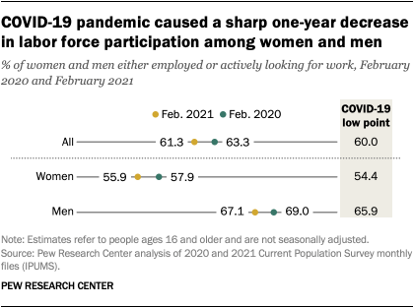
Labor Force Change – 2020 to 2021

Slide 4
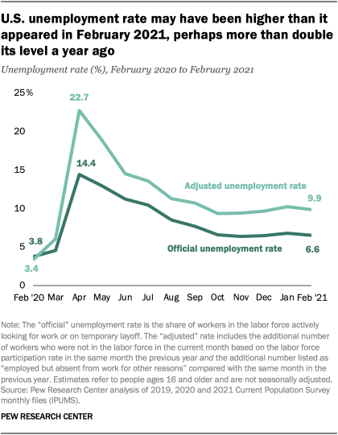
Unemployment – 2020 to 2021

Slide 5
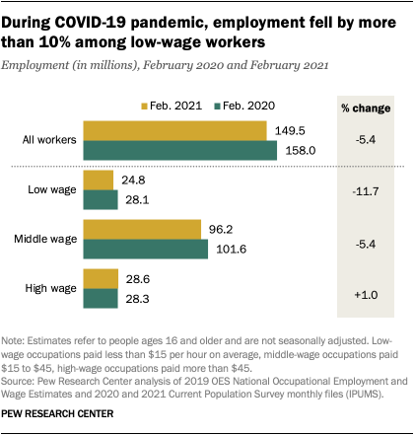
Employment Changes by Wage

Slide 6
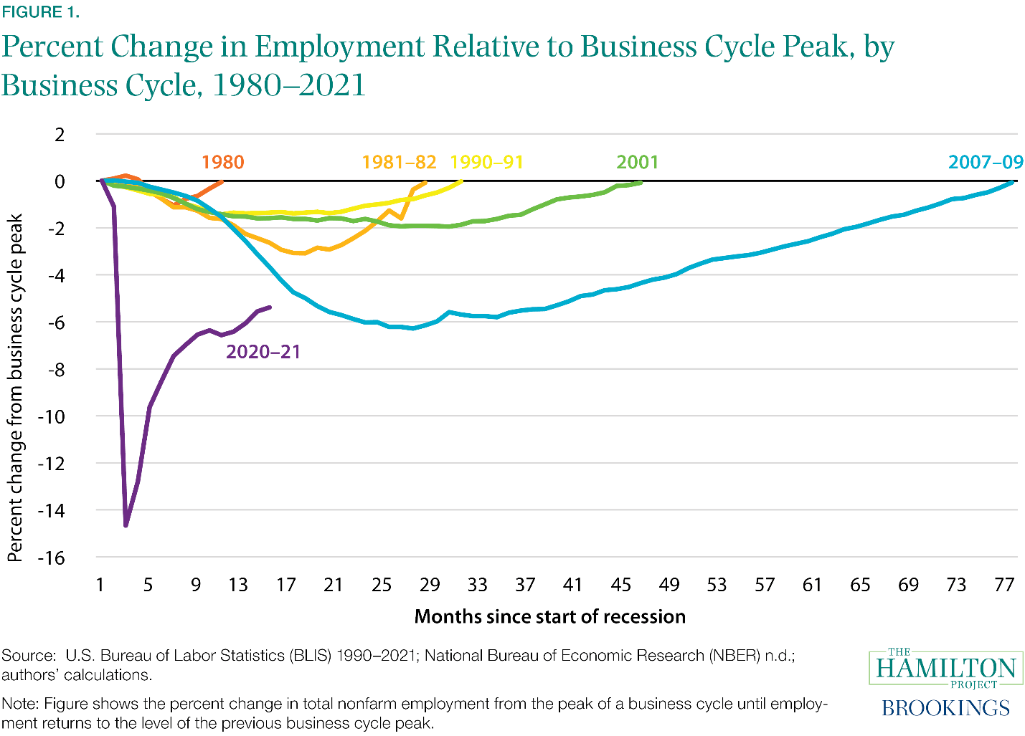
Employment and Business Cycles

Slide 7
Where are We Now?
BLS Unemployment – 5.2%
Participation Rate – 61.7%
5.7 million not currently in a job, looking for a job
5.6 million reported their lack of work was due to pandemic related job reductions, closures, etc.
10.9 million job openings
Healthcare Employment = 20 million
Healthcare Unemployment = 3.9%
Annual RN Openings – 194,500
Projected RN Job Growth to 2030 – 9%

Slide 8
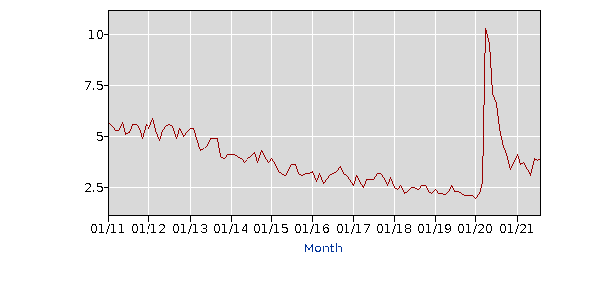
Healthcare Unemployment

Slide 9
Healthcare Unemployment Numbers
Industry: | Health care and social assistance
Years: | 2011 to 2021
Year | Jan | Feb | Mar | Apr | May | Jun | Jul | Aug | Sep | Oct | Nov | Dec
2011 | 5.7 | 5.5 | 5.3 | 5.3 | 5.7 | 5.1 | 5.2 | 5.6 | 5.6 | 5.4 | 4.9 | 5.6
2012 | 5.4 | 5.9 | 5.3 | 4.8 | 5.3 | 5.5 | 5.6 | 5.5 | 4.9 | 5.4 | 5.0 | 5.2
2013 | 5.4 | 5.4 | 4.9 | 4.3 | 4.4 | 4.6 | 4.9 | 4.9 | 4.9 | 4.0 | 3.9 | 4.1
2014 | 4.1 | 4.1 | 4.0 | 3.9 | 3.7 | 3.9 | 4.0 | 4.2 | 3.7 | 4.3 | 4.0 | 3.7
2015 | 3.9 | 3.6 | 3.3 | 3.2 | 3.1 | 3.4 | 3.6 | 3.6 | 3.2 | 3.1 | 3.2 | 3.2
2016 | 3.3 | 2.8 | 3.2 | 2.7 | 2.9 | 3.1 | 3.2 | 3.3 | 3.5 | 3.2 | 3.1 | 2.9
2017 | 2.6 | 3.1 | 2.8 | 2.5 | 2.9 | 2.9 | 2.9 | 3.2 | 3.2 | 3.0 | 2.6 | 3.0
2018 | 2.5 | 2.4 | 2.6 | 2.2 | 2.3 | 2.5 | 2.5 | 2.4 | 2.6 | 2.6 | 2.3 | 2.2
2019 | 2.4 | 2.2 | 2.2 | 2.1 | 2.3 | 2.6 | 2.3 | 2.3 | 2.2 | 2.1 | 2.1 | 2.1
2020 | 2.0 | 2.2 | 2.8 | 10.3 | 9.5 | 7.1 | 6.6 | 5.4 | 4.5 | 4.1 | 3.4 | 3.7
2021 | 4.1 | 3.6 | 3.7 | 3.4 | 3.1 | 3.9 | 3.8 | 3.9

Slide 10
Where are We Now? Optimism?

Slide 11
Where are We Now? Challenges

Slide 12
Where are We Now? Staffing…

Slide 13
Quick Snapshot
Zip Recruiter – 156,041 openings on 9/14
Indeed – 54,406 openings on 9/14
Indeed – 40,307 SNF staff openings on 9/14
Average age of an RN in 2018 was 50!
Projected RN retirement between now and 2030 – 1 million
2019 – 80,407 qualified applicants could not get into an undergrad or graduate nursing program due to shortages of faculty
Labor Purchasing (paying WAY up) has shifted labor supply to certain areas.

Slide 14
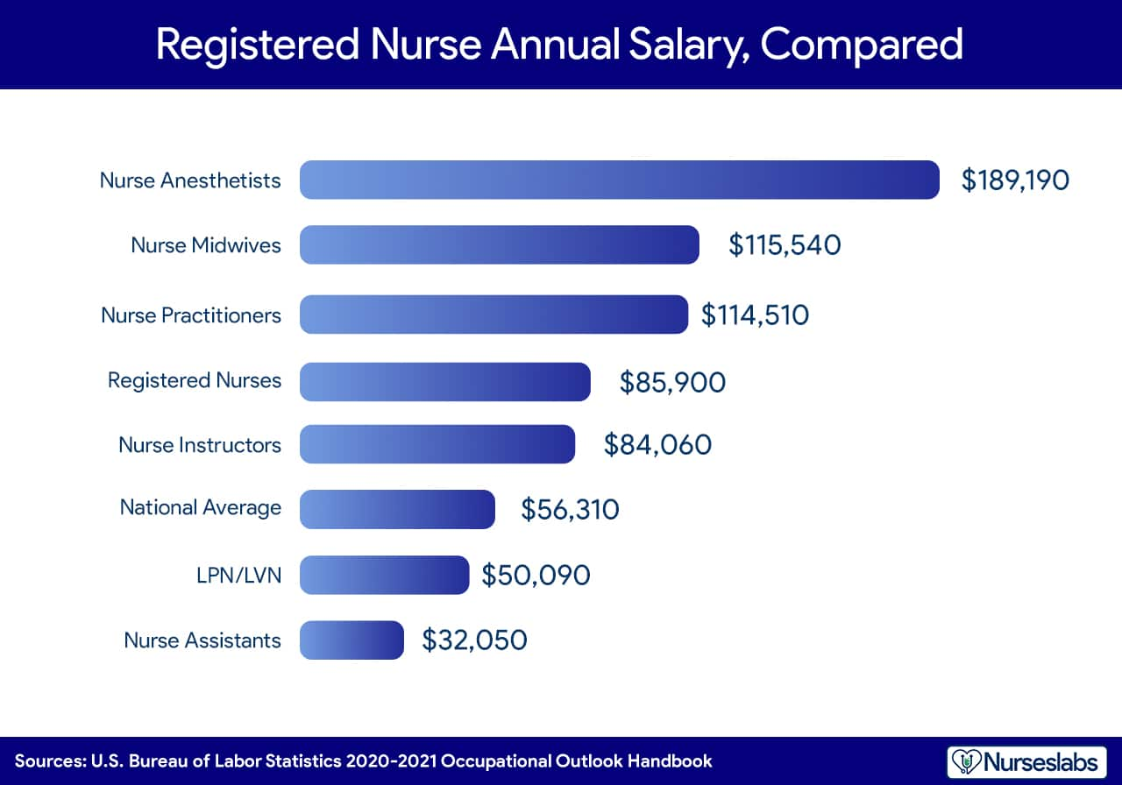
Nursing Wages

Slide 15
What Money Doesn’t Buy
Sign-on bonuses have minimal impact and low retention
Productivity is not a coefficient of rising pay
Pay must be competitive but higher rates are often trade-offs with other compensation
We know variability of reward plus frequency matters most to staff = especially with regard to retention
No true parallel plane for all staff – everyone works for pay yes, but not all for max pay
The higher the professional component of the work, the less pay is a main driver of job satisfaction and/or retention

Slide 16
Attracting Staff to the Table
Internal referral programs work BEST – people like to work with people they know, trust.
Job shadowing and “test drives”/virtual work days are attractants
No commitment, temp opportunities
Social media impact for younger staff
Sneak peek events and mixers
Employee ambassadors that GO TO potential employee locations – college campuses, parties, social events, etc.
Employee cam videos – employees wear a video cam and record a “day in the life of”…

Slide 17
Data to Know – Source: Apollo Tech
65% of employees in the US are satisfied with their job
20% of employees in the US are passionate about their job
60% of employees believe that their coworkers are the biggest contributor to their happiness at work
Companies with high worker satisfaction outperform low satisfaction companies by 202%
45% of Generation Y (Millennials) are completely satisfied with their current job/career path
74% of employees in the US believe that company culture is one of the biggest contributing factors to job satisfaction
57% of employees that work from home are satisfied with their job
81% of employees in the legal industry find their job boring and dissatisfying

Slide 18
Leverage: Can You Use the Data to Improve Staffing Results
Tip – Get your employees involved. Culture matters
Tip – Marry incentives to staffing changes. Stop sign-on bonuses, up referral incentives
Tip – Half of staffing challenges tie to reducing turnover
Tip – Pay for stuff that matters – stop paying for what doesn’t
Tip – Reduce unnecessary stuff – too many meetings, too many requirements
Tip – Improve positive messaging, reduce negative messaging.
Tip – Leverage your own data – your customers, your quality

Slide 19
Stuff I’ve Seen that Works
Stack shifts – four hour increments
Pay Weekly, Advance Daily
Flex Benefits
Instead of sign-on bonus, tuition reduction plans
Self-scheduling/Team Scheduling
Tuition augmentation programs (dollars for tuition)
Week on/Week Off
Two person/Three person Teams for scheduling
Management work-alongs

Slide 20
Evolving Best Practices
Staff scheduling
Teams vs. Individual Schedules
Pay flexibility (frequency, benefits, etc.)
Lifestyle benefits
Management/Staff Engagement programs
Workplace engagement – focus on reducing bureaucracy, building team, having fun
Schedule Flexibilities (10 hour, 12 hour, 4 hour stacks, seven on seven off, three on three off, etc.)
Virtual day care/school

Slide 21
My Top Five
Stop recruiting positions and titles – recruit PEOPLE. Focus on the work place environment
Use Staff to recruit Staff
Partnerships are Awesome – Schools, etc. Tuition partnerships, learning partnerships, etc.
Flex Comp as Much as Possible
Schedule Creatively – The Old Model is DEAD

Slide 22
Reminders: Don’t Forget!
Culture matters as much if not more than pay
Workplace satisfiers are about engagement and involvement – not control
Most staff enter healthcare because of an internal driver to do good work – they care.
Retention = recruitment. Poor retention, recruitment will be challenging
Staff can’t be stolen – If they are being poached, the organization is giving them a reason to BE POACHED.
ASK what matters, LISTEN and Be PREPARED TO own the issues!

Slide 23
Thank-you! And the winners are?
Questions, comments, etc.
Contact: rhislop@h2healthllc.com

