Slide 1


Slide 2
Care Coordination Model for Improved Outcomes and Satisfaction
Reginald M. Hislop, III
Diane R. Hislop, RN
Jennifer Maina, RN
Ed Cornejo

Slide 3
Presenters
Reginald M. Hislop, III – President and Chief Executive Officer of Larksfield Place
Diane R. Hislop, RN – Senior Partner for H2 Healthcare, LLC
Jennifer R. Maina, RN – Director of Nursing/Resident Care Services of Larksfield Place
Ed Cornejo – Vice President of Home Care for Larksfield Place Home Health

Slide 4
Larksfield Place
Life Plan community in Wichita, KS
190 Apartments and Villas
83 SNF – average 30 Med A, 48 Long Term/private pay – 5 Star in every category – only SNF in 100 mile radius, all 5 Star
72 Assisted Living Units
Medicare/JCAHO Accredited Home Health Agency
Therapy – on-site, all employees (no contract)
Pharmacy – contract with Alixa Rx

Slide 5
Today – the Presentation
We will cover the following;
  The role of Care Coordination in the current policy and compliance environment, primarily on a short-stay basis
  How the Larksfield Care Coordination model was built and how it has worked to date (outcome data, successes, failures, etc.).
  Review best practice tools that we have developed such as clinical pathways, protocols, care algorithms.
Demonstration: A live “mock rounds” event with audience participation!

Slide 6
Care Coordination – Short Stay
Transcend typical discharge planning by developing a resident focus, starting pre-admission.
  Mapping resident outcome desired with team responsibilities
  Focus on early discharge planning steps such as home safety eval
  Incorporating resident preferences at initial care team meeting (within 48 hours)
  Regrouping with resident weekly to update progress, identify issues, and continue to plot course toward resident outcome (generally discharge)
  Integrate post-discharge requirements ASAP such as home health, return to PCP, medications, outpatient services.

Slide 7
Care Coordination – Long Stay
Resident-centered focus, primarily on;
  Palliative approach
  Reducing unnecessary treatments, medications, and care transitions
  Expanding choice and objectifying the resident day (when they rise, when they eat, what they eat, activities, etc.)
  Education and support for family and caregivers as resident changes
  Incorporate the physician and other health providers to minimize changes in resident care needs and focus on “benefit” versus activity (lab tests that won’t necessarily lead to a change in care or weekly vitals for no reason).

Slide 8
Policy Dynamics: Value Based Purchasing
Care Coordination is about a model that focuses intra and inter disciplinary approaches
Centers on the resident journey and resident goals
Involves coordinating post-discharge resources
Involves care completion and patient teaching as key elements
Includes post-discharge follow-up and contact
Reduces readmissions and other care transitions

Slide 9
Bundled Payments
While mandatory markets for CJR have shrunk, etc. and other bundles delayed, projects still go forward on a voluntary basis.
Care Coordination works on a road-map approach – utilizing algorithms and protocols to enhance care delivery, reduce waiting times, keep patient progress foremost, and address care concerns and issues fluidly – lengths of stay are shorter
Best practices are used to encompass the FULL patient journey – inpatient, home health, outpatient

Slide 10
IMPACT Act
Care Coordination focuses on core IMPACT Act goals;
  Making care safer by reducing harm caused in the delivery of care.
  Ensuring that each person and family is engaged as partners in their care.
  Promoting effective communication and coordination of care.
  Promoting the most effective prevention and treatment practices for the leading causes of mortality, starting with cardiovascular disease.
  Working with communities to promote wide use of best practices to enable healthy living.
  Making quality care more affordable for individuals, families, employers, and governments by developing and spreading new healthcare delivery models.

Slide 11
IMPACT Act, continued
Key measure domains under the Act that are incorporated within Care Coordination;
  Transfer of health information and care preferences when an individual transitions;
  Resource use measures, including total estimated Medicare spending per beneficiary;
  Discharge to community; and
  All-condition risk-adjusted potentially preventable hospital readmissions rates.

Slide 12
Medicare Advantage
Care Coordination facilitates the shorter stays required plus the frequency of justification of patient progress.
Weekly meetings and documentation of updates can assist the MA plan with identifying and corroborating, length of stays
Provides a fluid qualification process for home health or outpatient services

Slide 13
Federal Conditions of Participation
The following compliance requirements/ F Tags are satisfied by the Care Coordination program
  F 553 – Right to participate in care planning
  F 561 – Self Determination
  F 622 – Transfer and Discharge
  F 623 – Notice before transfer
  F 624 – Orientation for Transfer or Discharge
  F 660 – Discharge planning
  F 661 – Discharge summary
  F 655 – Baseline care plan
  F 656 – Develop/Implement Comprehensive Care Plan
  F 657 – Care Plan timing and revision

Slide 14
Care Coordination
A Team Approach to address Resident discharge or transition needs while developing a person-centered care plan that is flexible and reviewed weekly.
Team consists of: Team Leader/Facilitator, Nurse, CNA, Therapist (may be OT, PT or ST). Ad Hoc members are Social Work, Nutrition/Food Service, Activities depending on Resident needs and preferences.
Each member must know the resident and be directly involved in his/her care.

Slide 15
Rounds Process
Initial meeting with Resident – 48 hours or sooner after admission.
Schedule involves a weekly contact with the resident to update progress, make adjustments to care plan, etc.
Team huddles before and after to address concerns or continuity.
Each meeting is 5-7 minutes. Summary is printed and placed in resident record and in resident room.
Care rounds are NOT a Care Conference – if Resident and Family wish in-depth time, that meeting is separately schedule.

Slide 16
Role of Team Leader
Coordinate Rounds with Team members and schedule at least 24 hours in advance.
Team Leaders;
  Keep process moving
  Assure follow-up from issues identified during rounds
  Produce “My Journey” book.
  Coordinate discharge including orders, prescriptions, Home Health.
  Coordinate other services and mediate any changes or concerns to care plan to assure consistency and accuracy

Slide 17
The Process/Protocol
Nurse Navigator alerts team of Admission – info. re: hospitalization, reason for admission, dx, history, etc. plus preliminary goal is provided.
Team meets Resident within 48 hours of admission – initial care plan developed
Home safety evaluation is conducted (if resident discharge home is planned).
Rounds weekly and discharge plan is built. Other services are integrated as discharge is near (home health, outpatient, etc.)

Slide 18
Case Study: Resident - Joe
Joe was an actual resident – one of our first as we rolled out the Care Coordination process.
The following slides contain information and actual forms, etc. that are part of the process. During the next slides, I will review the case of Joe.

Slide 22


Slide 23
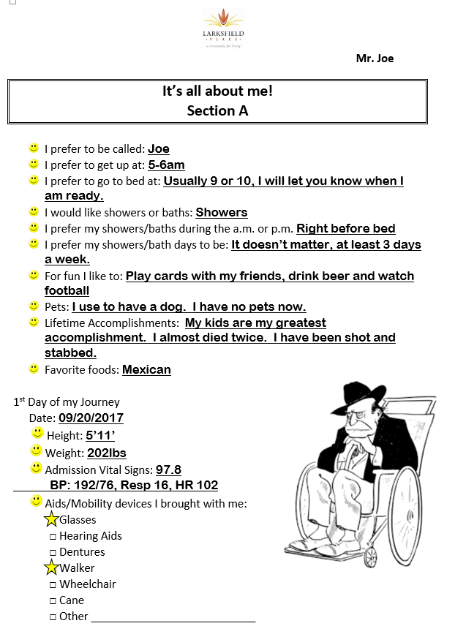

Slide 24
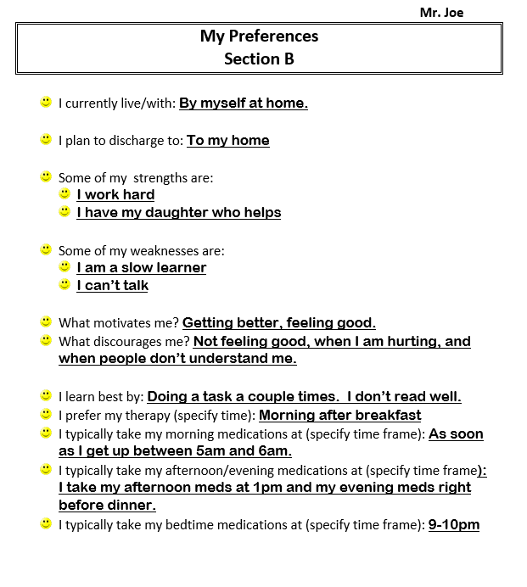

Slide 25
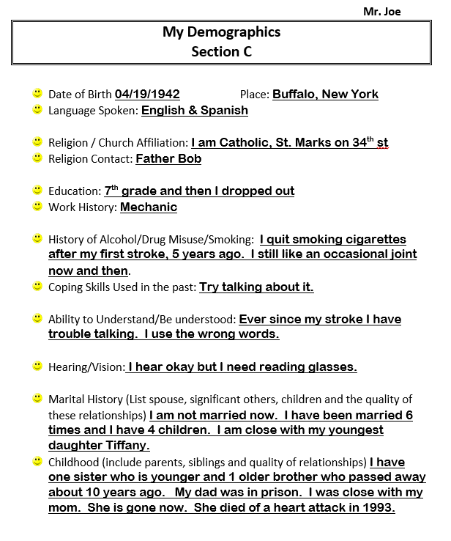

Slide 26
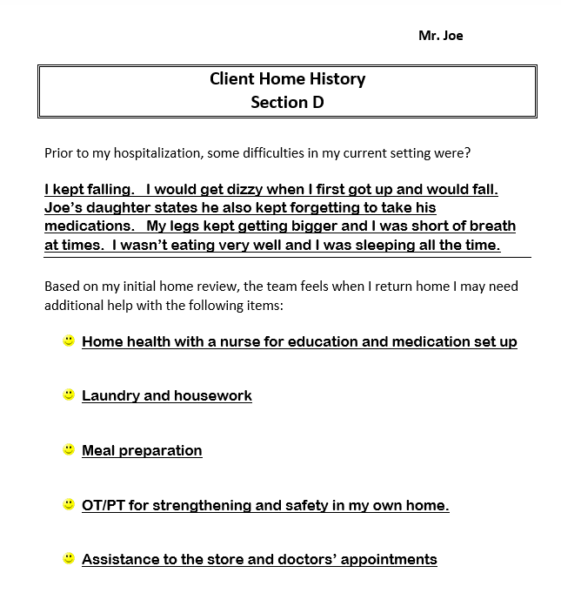

Slide 27
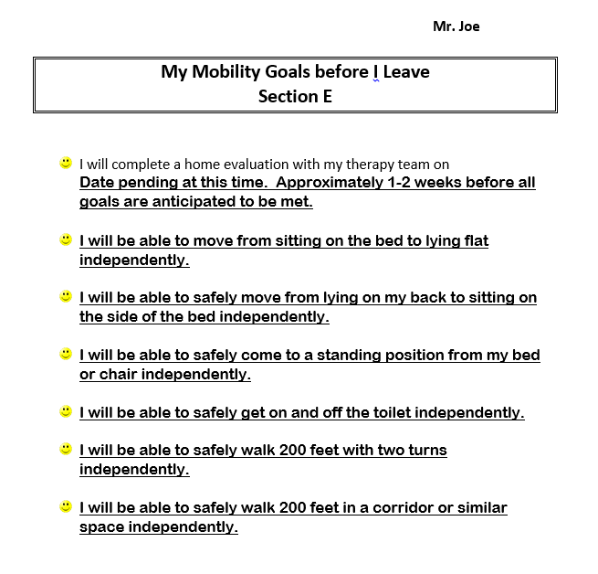

Slide 28
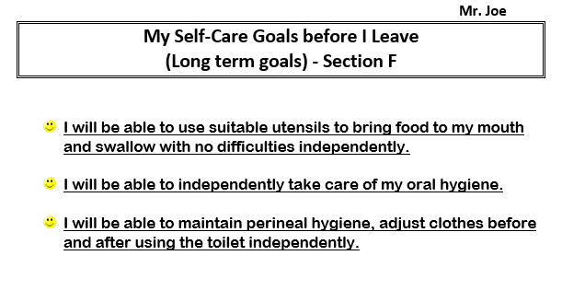
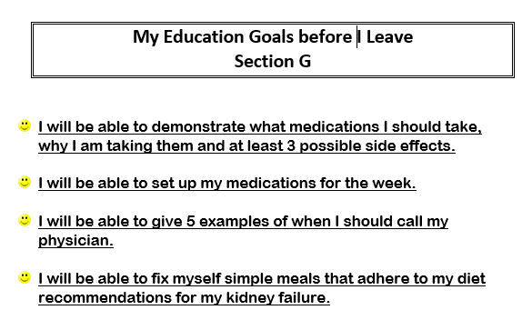

Slide 29
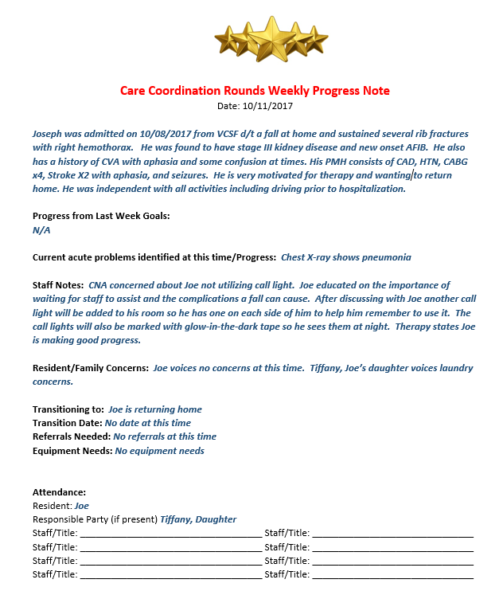
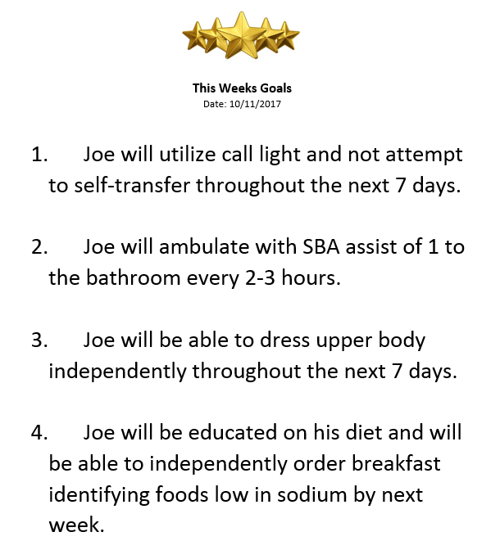

Slide 30
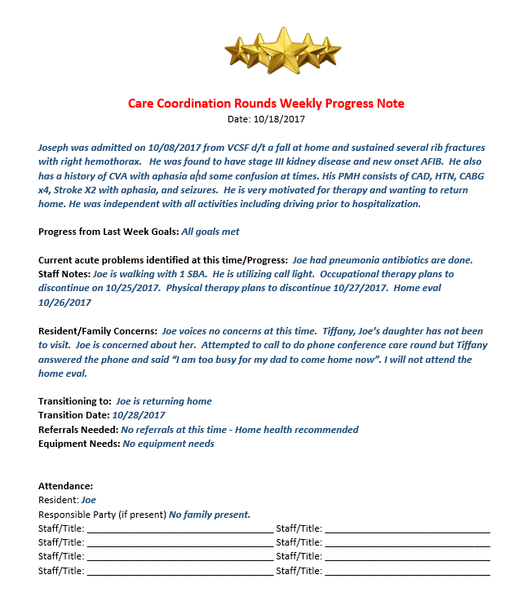
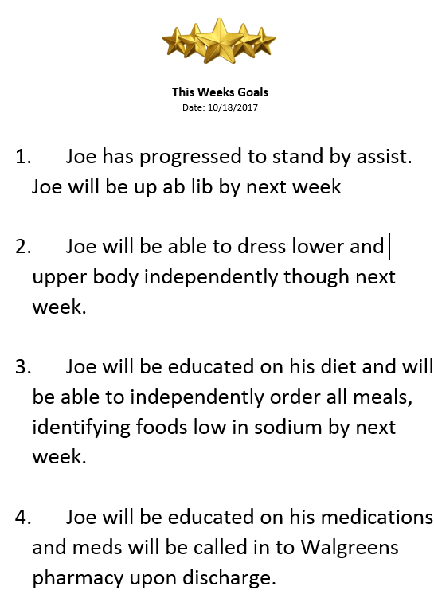

Slide 31
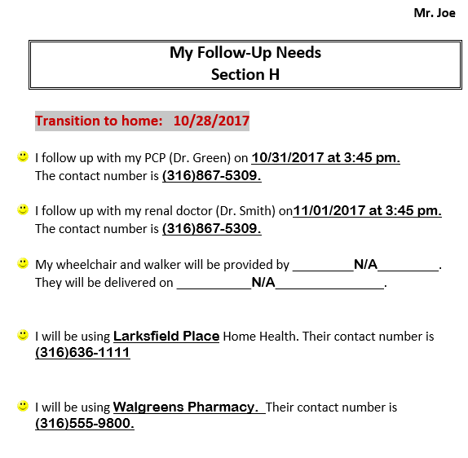

Slide 32
Care Coordination: Discharge to Community
Care Coordination includes the transition from inpatient to community.
Encompasses Transitional Care/Stay, Home Health and/or Outpatient
Begins before discharge from the SNF
Integrates the Home Health and Community Service aspects as part of the Coordination Team, a week or more prior to discharge.
Focuses on successful transition back to the community setting

Slide 33
Care Coordination: Home Health
Continuation of the inpatient stay – progress and completion
Enhanced opportunity for additional therapy and patient education
Development of improved opportunities for disease management
Typical encounter – 36 days, can be shorter if primarily orthopedic focused
Flexibility to provide more care to the patient without barriers of outpatient or cost (Part A Medicare = $0 copays)

Slide 34
Care Coordination: Transitional Care
Residential/Assisted Living stay if direct discharge home is not appropriate
Includes Home Health – for skilled nursing and continued therapy
Home Health typically will follow/continue once the transitional stay is complete – usually within 30 days
Excellent option for residents that cannot discharge direct home due to continued safety issues, etc. yet Medicare coverage in the SNF has ended or Med Advantage pushes discharge

Slide 35
Care Coordination: Outpatient
Appropriate for some but most complex or more complicated cases, warrant Home Health
Limited in terms of frequency and overall number of therapy sessions due to Medicare rule (MMPR, etc.)
More expensive for resident due to copays
Limited revenue potential for the provider

Slide 36
Post Discharge Data
From Nov.1, 2016 to Oct. 1, 2017
  275 Discharges
  92 Admitted to Larksfield Home Health
  Average LOS 46 days
  4 Hospital Re-Admissions
  10 Emergency Room Encounters

Slide 37
Welcome Home Program

Slide 38
5 Day Post Discharge Questionnaire

Slide 40
QAPI Data: What We Track/Measure
Length of Stay Inpatient
Discharge Destination
Length of Stay – Home Health. Our goal is 35 days “average”
Satisfaction – at 30 days, 60 and 90 days
Discharge Check-In – at discharge, within 5 days then 30 days
Incidents at Home – Falls, Infections and other occurrences
Care Transitions – ER, Hospital primarily

Slide 41
Biggest Challenges Post-Discharge
Medication compliance
Connection back to PCP
Overall compliance with therapies, etc.
Lifestyle and safety
Need for ongoing patient education

Slide 42
Upcoming: Virtual Care Coordination and Other Services
More technology and possible use of tele-medicine
More utilization of Transitional Care options – possibly direct from community or hospital
Home Health being the starting point – direct admit
Hospice as part of the equation
Improving our Chronic Care capacity and capability (e.g., dialysis)
Integration of private duty to provide more care for those without family or community support

Slide 43


Slide 44
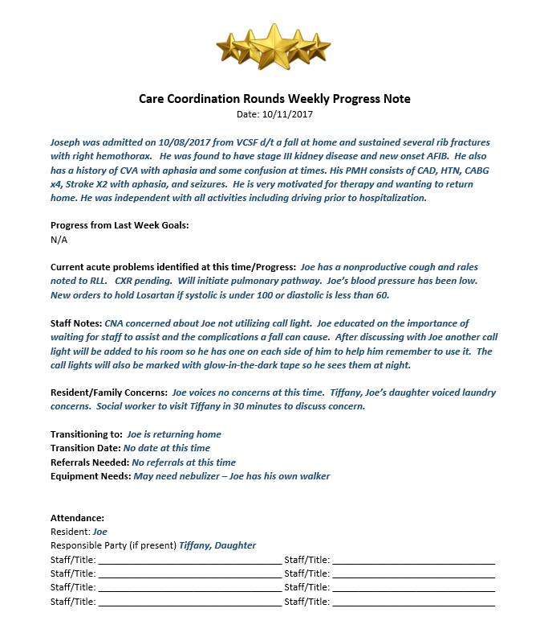

Slide 48
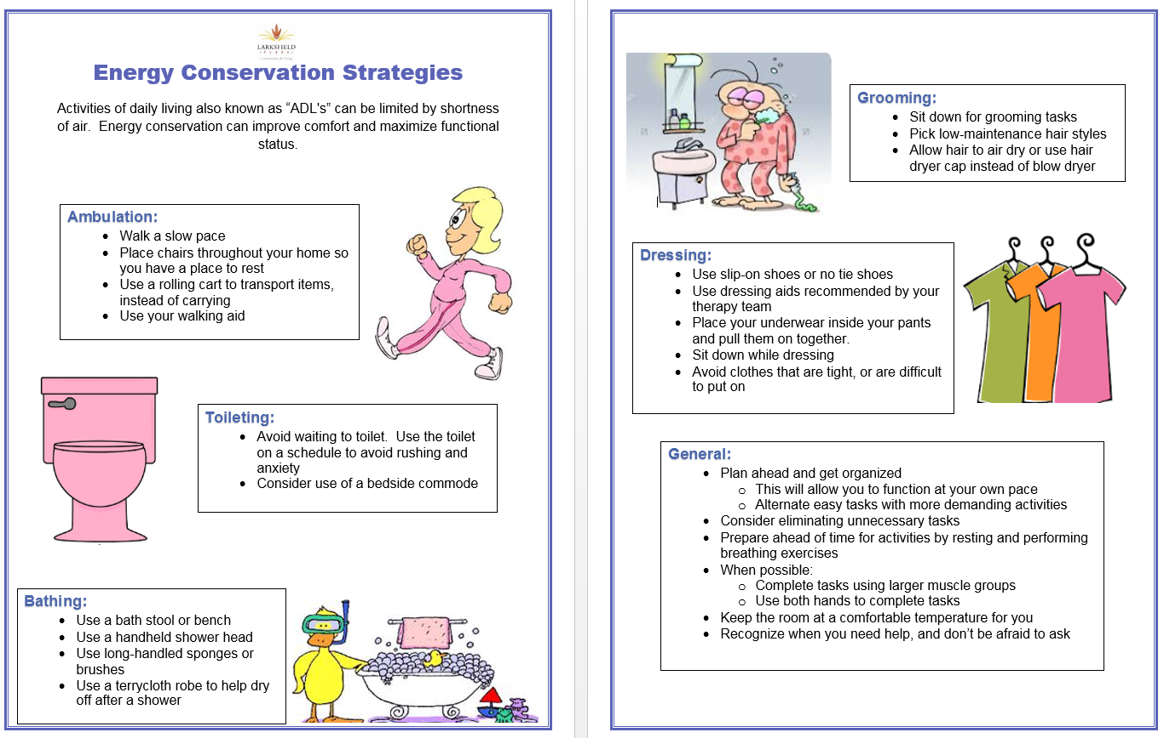

Slide 51
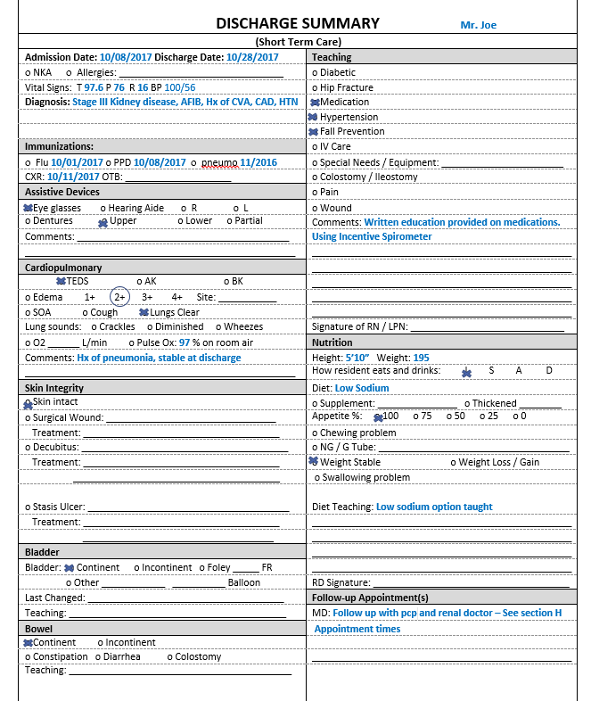
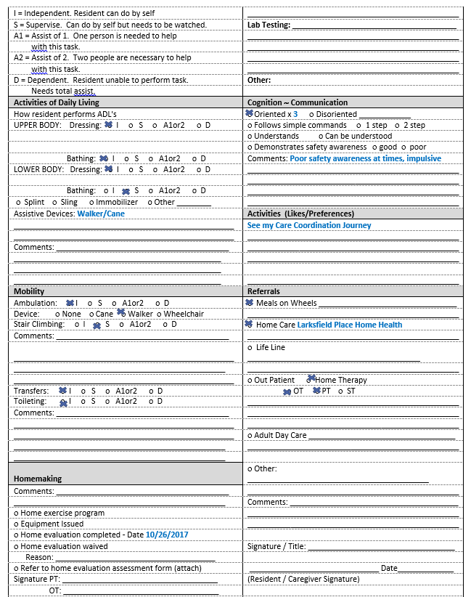

Slide 52
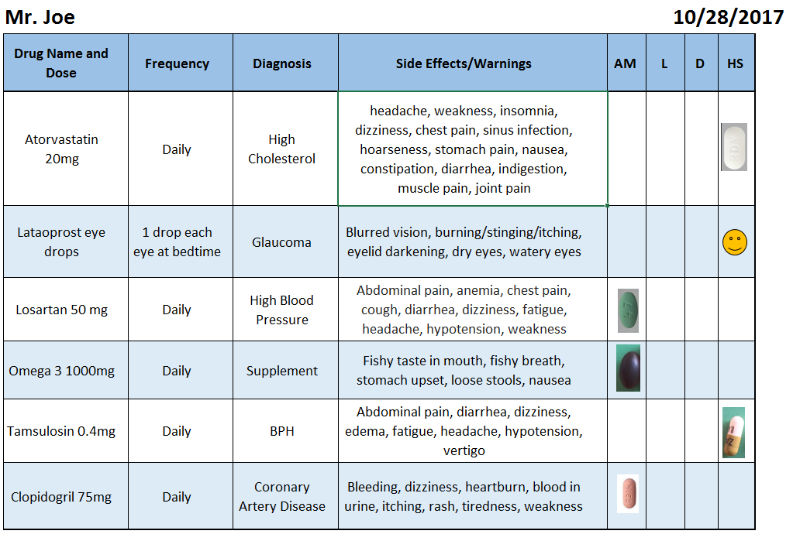

Slide 53
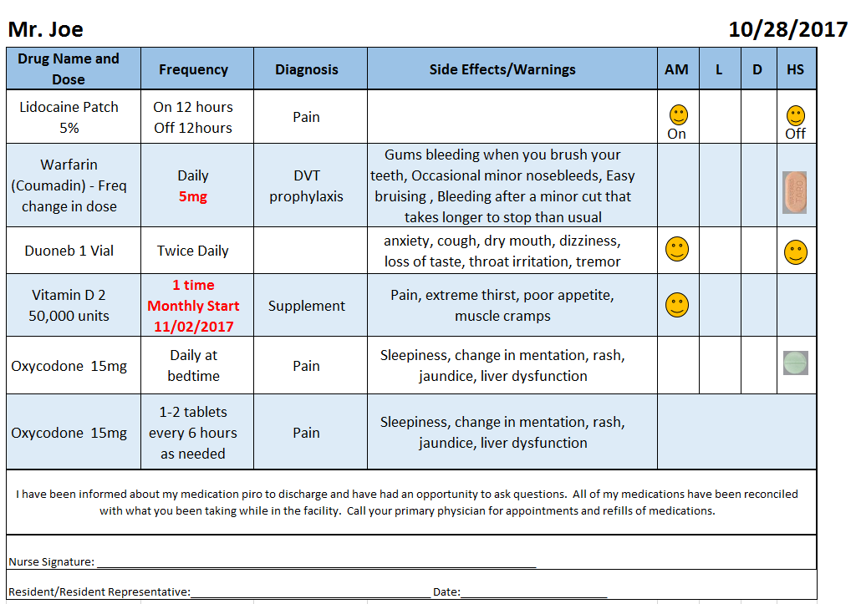

Slide 54
Questions?
Follow-up questions or comments on this presentation and materials, please direct to:
Jennifer Maina, RN at jmaina@larksfieldplace.org
Ed Cornejo at ecornejo@larksfieldplace.org
Thanks for Attending!

