Slide 1
Medicare is bankrupting america
Reginald Hislop, iii

Slide 2
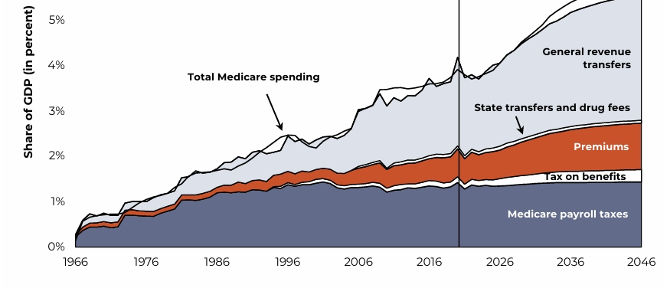
The finances of Medicare

Slide 3
The Numbers don’t add up
As increasing amounts of general tax revenues have been devoted to Medicare, less tax revenue has been available for other priorities such as deficit reduction or investments that could grow the economic output of the country.
While Medicare enrollment is rising, the number of workers per beneficiary is rapidly declining. These diverging trends present a financing challenge for Medicare because Part A Hospital Insurance is primarily financed by workers’ Medicare payroll taxes. The number of workers per Medicare beneficiary with Part A Hospital Insurance declined from 4.5 workers per Medicare beneficiary at the program’s inception in 1967 to 2.8 workers per beneficiary in 2023 and is projected to fall to 2.5 workers per beneficiary by 2029.
Medicare spending doubled between 2010 and 2023, increasing from $0.5 trillion to $1 trillion on a nominal basis. > Medicare spending is expected to again double between 2023 and 2032, when it is projected to reach nearly $2 trillion. The Medicare Trustees and the Congressional Budget Office expect Medicare spending to increase at an average annual rate of about 7 percent during this decade.

Slide 4
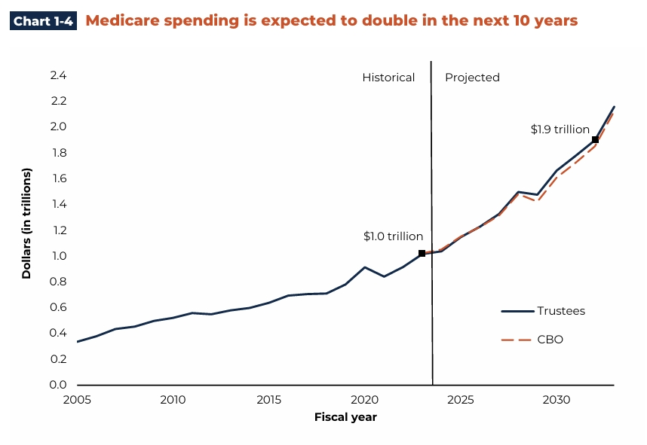
Spending doubles in the next 10 years

Slide 5
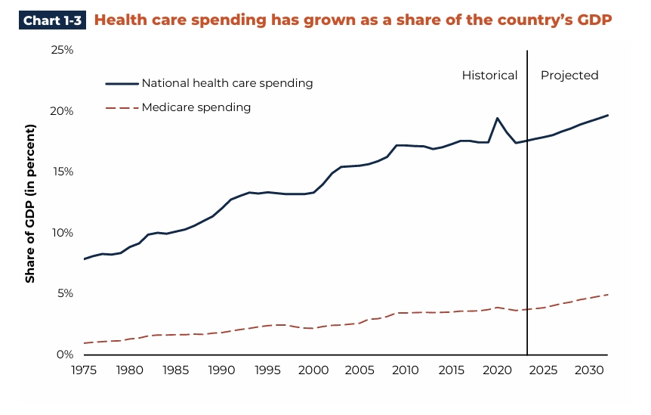
Healthcare Spending: Not helpful to GDP

Slide 6
Return on our investment?
Despite the country’s incongruous spending levels, the United States ranks well below other countries in many health outcomes. The average U.S. citizen lives to be 77 years old — three years lower than the average life expectancy of 80.4 years in high-income countries.
Total U.S. Healthcare Spending
In 2024, U.S. national health expenditures reached $5.3 trillion, growing 7.2% from the prior year.
This equated to $15,474 per person (per capita), up from previous years and driven by increased utilization of services like hospital care, physician services, and prescription drugs.
Per Capita Spending Comparison; The U.S. consistently ranks highest among high-income nations:
U.S.: ~$14,885–$15,474 per person (2024 estimates; some sources cite $13,432–$13,473 for 2023, with growth pushing it higher).
Switzerland (second highest): ~$9,963.

Slide 7
ROI, continued
Average for comparable wealthy OECD countries (excluding U.S.): ~$7,371–$7,393 (roughly half of U.S. levels).
OECD average overall: Significantly lower, with the U.S. at about 2.5 times the average in recent OECD Health at a Glance reports (e.g., over $14,880 vs. OECD avg. implied around $6,000).
Other high-income peers (e.g., Germany, France, Canada, Japan, UK) typically spend $6,000–$10,000 per capita, often less than half the U.S. figure.
Higher prices for services, procedures, drugs, and provider compensation (not higher utilization—U.S. patients often have fewer doctor visits, shorter hospital stays, but pay much more per unit).
Administrative costs (e.g., multi-payer complexity, billing, insurance overhead) are notably higher in the U.S. (~$1,000+ per capita vs. much lower in peers).
Prescription drugs and other factors play a role but are smaller contributors.

Slide 8
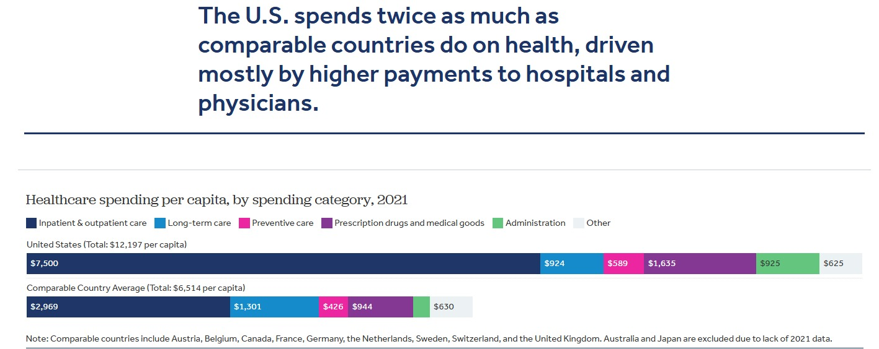
U.S. vs. Other countries

Slide 9
What’s driving the cost?
Demographics: 2.8 workers per beneficiary now, 2.5 by 2029. Compare to 4.5 per beneficiary in 1967. This funding model/equation no longer works.
Waste, Fraud and Abuse: GAO estimates $500 billion annual healthcare fraud. Administrative expense is now 40% of spending ($2.2 trillion) = NO BENEFIT TO PATIENT CARE
Program Inefficiency/Expense: Medicare Advantage costs Medicare/the govt., 20% more per enrollee than traditional Medicare (FFS) – 55% of all beneficiaries are Medicare Advantage.
  Low cost drug programs like 340B now over $45 billion annually with zero evidence that any drug cost savings benefitted patients. The 340B law has no guardrails but prevents Medicaid from collecting rebates on prescriptions filled at the 340B price. Exploitation of 340B by non-profit hospitals is enormous.
Structural Imbalances: From huge regional cost differences to payments made by site specific criteria not by care or by efficient location, to rising drug costs due to no formulary control on brand drugs, etc.

Slide 10
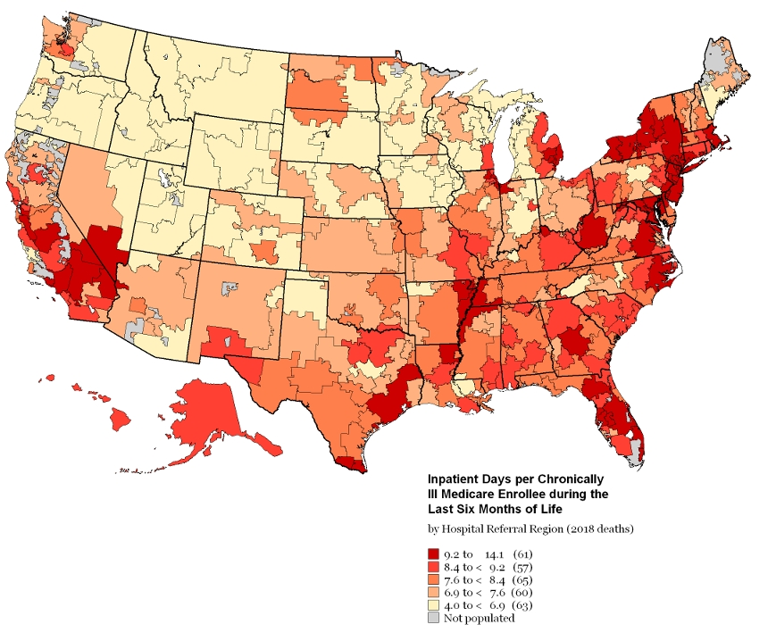
Utilization Differences under medicare

Slide 11
Medicare Advantage v. fee for service
In February 2025, enrollment in MA plans, which are paid on a risk-adjusted basis, reached 34.4 million, or 55 percent of all eligible Medicare beneficiaries (only beneficiaries enrolled in both Part A and Part B are eligible to enroll in an MA plan).
The risk-adjustment model used by Medicare to adjust payments to plans is based on FFS data and therefore reflects the expected spending and diagnostic-coding patterns in FFS Medicare. The model accounts for differences in demographics and recorded diagnoses.
Plans that document relatively more diagnosis codes therefore have a competitive advantage over other plans. In contrast, the payment policies in FFS Medicare offer relatively little incentive to code all diagnoses. This difference in coding incentives results in higher risk scores when a beneficiary enrolls in MA than if the same beneficiary had enrolled in FFS Medicare. As a result of higher MA coding intensity, the Medicare program pays more, on average, when a beneficiary enrolls in MA than it would if the same beneficiary were in FFS Medicare.

Slide 12
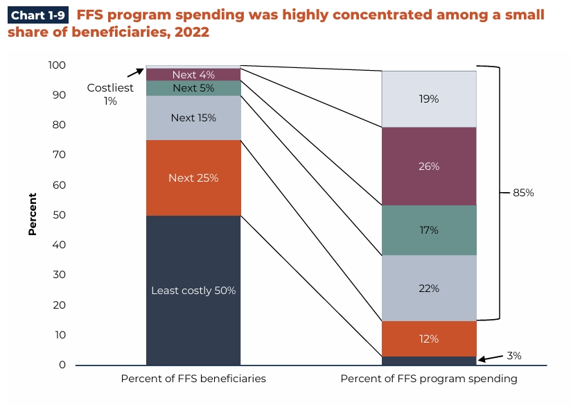
Fee For service spending

Slide 13
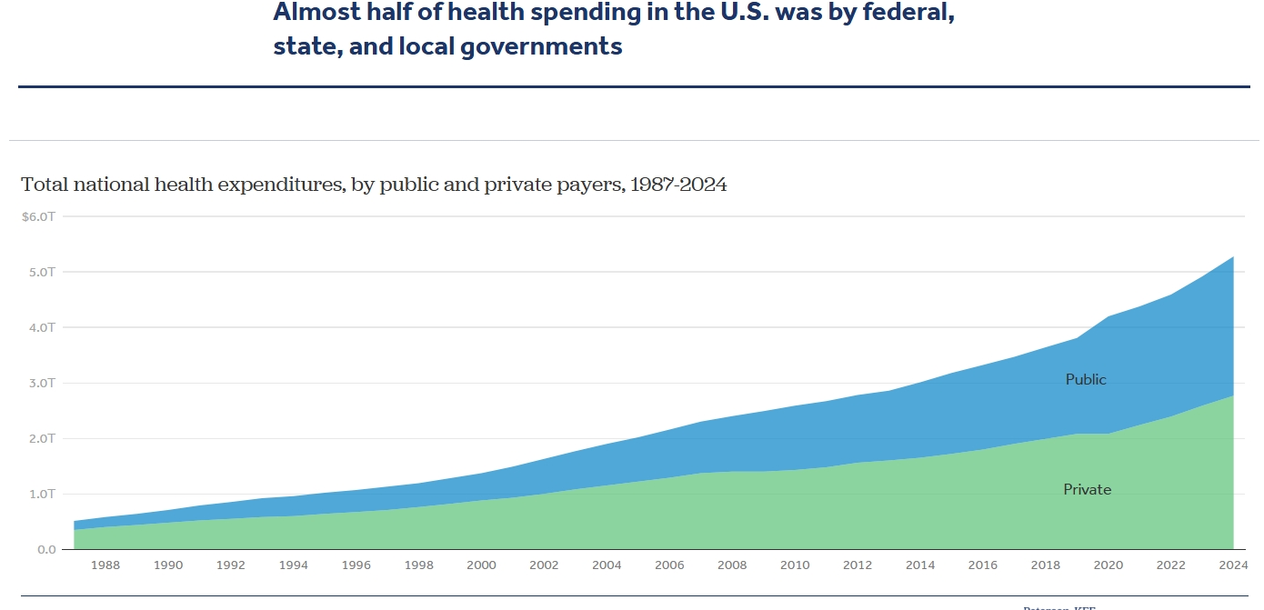
Is this fixable?

Slide 14
Political realities of reform
Basic Math: To extend the solvency of the HI Trust Fund two options stand out: (1) increase the Medicare payroll tax from its current rate of 2.9 percent to 3.35 percent or (2) reduce Part A spending by 10.6 percent, which is equivalent to a reduction of about $52 billion in 2026, that would then need to be maintained in subsequent years. Either of these approaches would extend the solvency of the trust fund for an additional 25 years.
Program Reforms: Revamp Medicare entirely in a phased process that simplifies payments and claims, eliminates non-care regulations, reduces over- capacity, creates competition among providers, restructures abuse focuses, reduces incentives for upcoding, ends ineffective, non-essential programs or reforms them wholly such as 340B and Medicare Advantage.

Slide 15
Private style reforms
Competition: End restrictions on physician ownership in hospitals (Obama Care). Forbid CON laws in any state. Extend site payment neutrality to all settings. Require full price transparency.
  End coverage mandates allowing private plans to provide Medicare-style options. No more requirement for each participant to have Medicare D or B. via the govt.
Level the Playing Field: Medicare incentivizes utilization and disengages primary care via endless bureaucracy and non-competitive payments. Getting to a level playing field requires.
  Reform Medical Education: U.S. has 2.7 physicians per 1,000 compared to peer nations with 3.8. Most other nations have around 1/3rd devoted to primary care. Only 12% of physicians in the U.S. are primary care. In the U.S. there are tight restrictions on training spots for new doctors plus the expense is far higher than peer nations – so high that the ROI on becoming a primary care physician is negative through the first 10 years of practice.
  More Primary Care: Better access, lower cost care, more prevention.

Slide 16
Medicare required reforms – national solutions
Bridge Eligibility: As retirement age advances, many folks 65 plus continue to work and have other insurance access. Medicare should not be automatic or required at 65. Allow Part A, B or D to be separately purchased at any point above 65. Encourage working folks to stay otherwise insured.
Reform: Stop paying hospitals, particularly non-profits, for uncompensated care and bad debt. Completely re-tool 340B.
  Remove uncompensated care payments from Medicare, index them to inflation, and base them on a hospital’s share of charity care and non-Medicare bad debt. This would provide an incentive for hospitals to provide more charity care, as they would be compensated at a higher rate. CBO estimates that this proposal would save $87.6 billion over 10 years.¹⁶ Policymakers should also end Medicare compensation of bad debt, which CBO estimates would save $54.1 billion over 10 years.
  The 340B Drug Pricing Program requires pharmaceutical companies to sell outpatient drugs to qualifying hospitals at a steep discount, usually 25-50 percent of the normal price. Currently, Part B pays these hospitals the average sales price (ASP) plus six percent for outpatient drugs, regardless of whether these drugs were actually acquired at a discount. Reducing Part B payments to ASP -22.5% would save $74 billion over 10 years.

Slide 17
More Solutions
Tort Reform: Stop one-sided litigation by adding the right of recovery to Defendants. Estimate suggest that savings of up to $100 billion are possible via reduced insurance, reduced administrative burden, reduced defensive medicine, near complete elimination of litigation to settle claims.
Medicare the Driver: Payment rates for nearly all healthcare programs including private, factor off of Medicare rates. Medicare rates need reform. Readjust the payment differences regionally. Update inflation measures to chained CPI or other vs. CPI. Rework labor regions and cost calculations. End provider submissions of data that have no relevance.
Claim Simplification: Standardize a single claim form and process, eliminating foolish and useless data collection such as Meaningful Measures and half to two thirds of the assessment data on post-acute admissions (MDS, OASIS).

Slide 18
The Vipers in the pits
Medicare reform is complicated by the number of Pigs that Feed at the Trough. From insurance companies to lawyers to consultants and accounting firms and drug companies, PBMs, and of course, politicians, the billions in overhead, waste, fraud and slush that does not benefit one patient, benefits all of these other players.
Medicare is an auto-pilot program that does not require Congress to vote on additional funding. Without spending accountability, its cost marches on.
Its complexity is the key to its madness in many ways. It seems too complicated to fix and most beneficiaries, like it…but then in reality, why not. What most people don’t see or understand is the big economic hole that Medicare has become and while they like the benefits and cost, the real cost is the societal and economic cost.

Slide 19
Where does this end?
Medicare can and will go bankrupt in the next decade but likely not as Congress will print more money for solvency.
It will consume more tax dollars, require more borrowed money and in turn, drag private GDP growth and help keep inflation fires smoldering (all of the printed money).
Reforms are actually very simple but difficult to apply as they require political capital and a willingness to be unelected.
As reform will take years, now is the time to begin. Kicking the can down the road has enormous economic implications (see Japan).

Slide 20
The end – questions, comments, discussion
Thanks. I am Reginald (Reg) Hislop III, Managing Partner at H2 Healthcare, LLC. Contact me at rhislop@h2healthllc.com. Twitter @H2HealthLLC

